Slide 1

SGM CCUV EBB Simulation

Slide 2
1. Sizing Summary
To be updated

Slide 3
2. AEB simulation results
Deceleration target | 1g
EBB | 0.1g | 0.2g | 0.3g | 0.4g | 0.5g | 0.6g | 0.7g | 0.8g | 0.9g
Auto apply time (start from EBB receive) / ms
ESC | 0.9g | 0.8g | 0.7g | 0.6g | 0.5g | 0.4g | 0.3g | 0.2g | 0.1g
Auto apply time (start from ESC receive) / ms
Pedal travel / mm
Force to pedal (foot applying central point) / N

Slide 4
3. AEB Simulation Parameters
Vehicle: CCUV
weight (GVW) 1920 kg
% Front weight 52.6%
COG / WB: 590 mm / 2700 mm
r_dyn: 343.75 mm
Hose_length: F:2x400/R:2x400 (assumed)
Pedal: Ratio 3.3 / max 125.4mm
Split: X
FA Brake: Ø 60 (Disc / r_eff: 119.5 mm / µ_nom: 0.34)
RA Brake: Ø 42 (Disc / r_eff: 127 mm / µ_nom: 0.34)
MC: 23.81mm (assumed MEB strokes in calculation)
EBB parameters to be added
80A as current limit
Other parameters to be assumed
EBC470 parameters to be UPDATED
80A as current limit
Other parameters to be assumed
Motor: 330W
ISO: FA: Ø 0.55 / RA: Ø 0.35
DUMP: FA: Ø 0.65 / RA: Ø 0.5
U_BAT: 13.5 V
Harness: 30 mOhm Cable tree + 8 mOhm ECU
Fluid: HN 404 at 23°C
Current Limitation: 80A
ECU Delay: 20ms

Slide 5
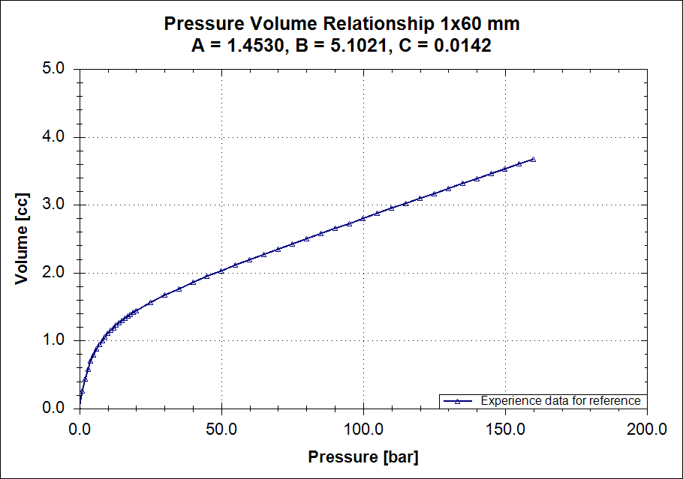
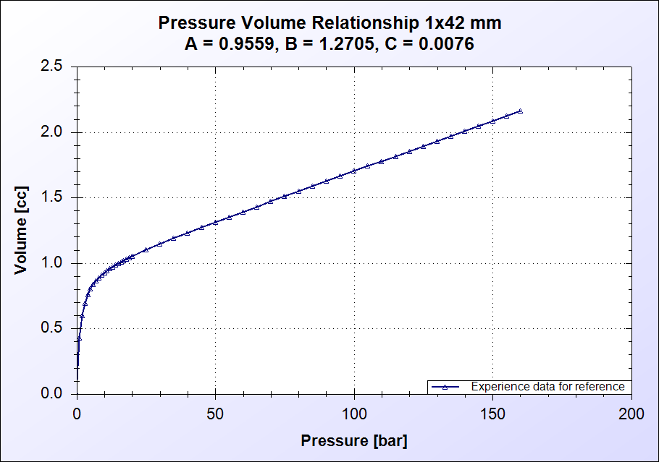
4. PV (w/o hose)
Front brake
Rear brake

Slide 6
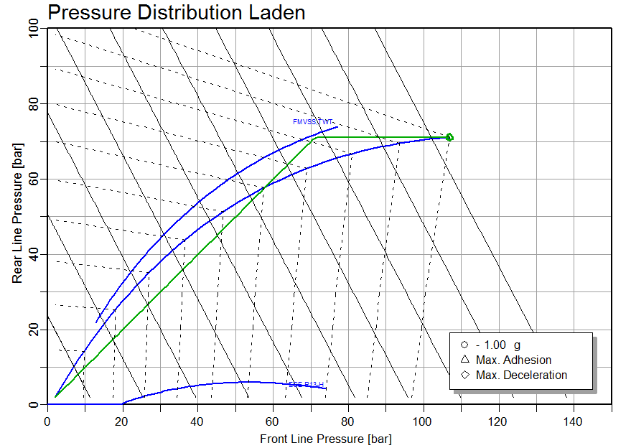
5. Brake force Distribution

Slide 7
6. Brake Control performances
EBB and / or ESC pressure building up curves to be added on this page and next pages

Slide 8
Thank You

Slide 9
BACKUP

Slide 10

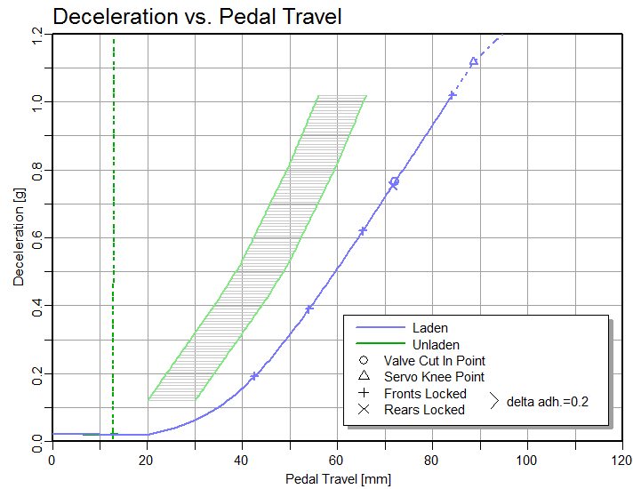
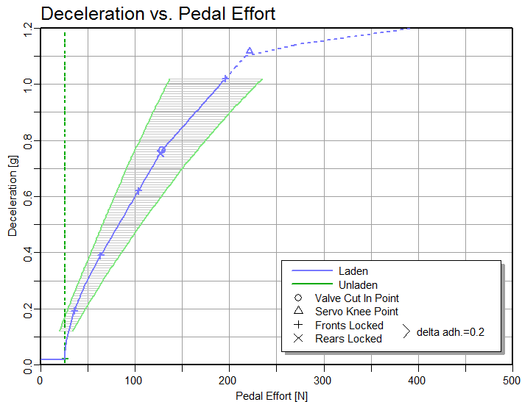
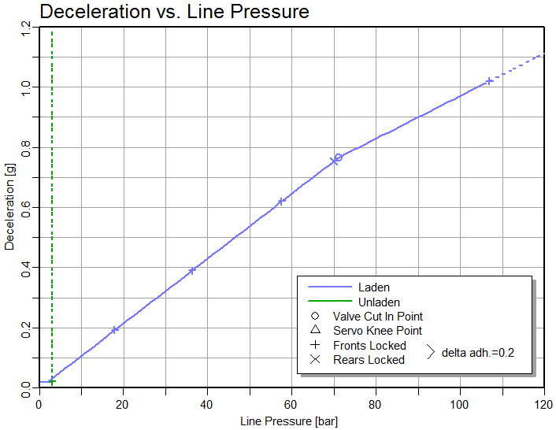
Foundation Brake System Sizing

